Slide 1
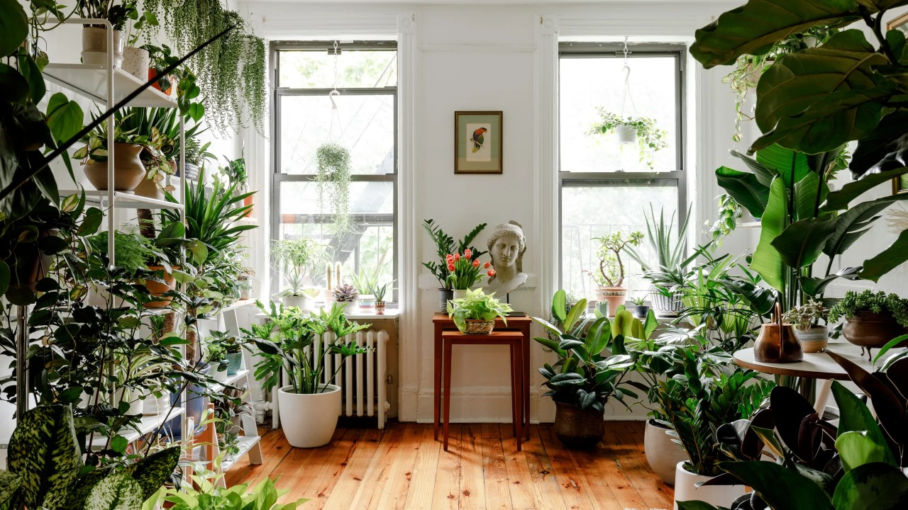
Plant Ownership
Plant choices of Minty Floats

Slide 2
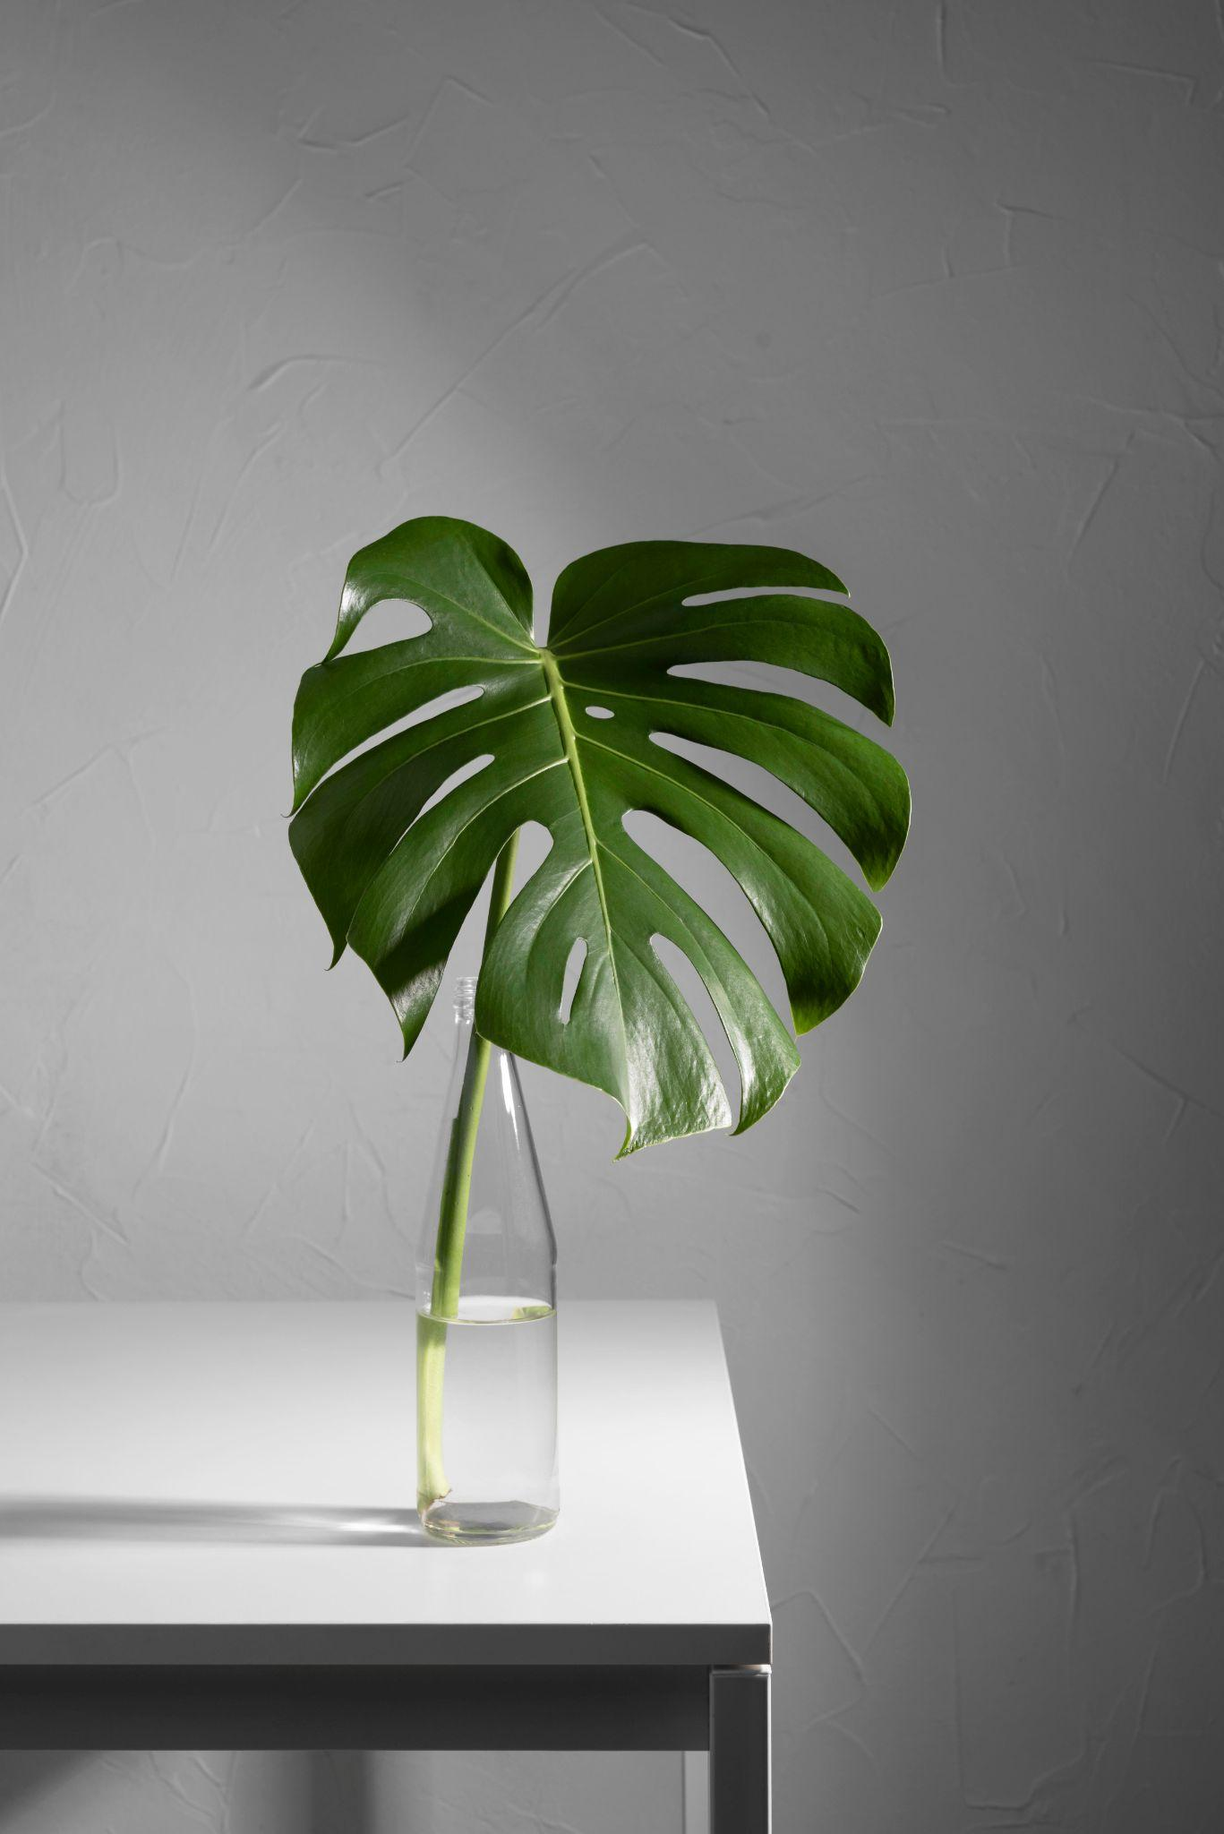
Agenda
Demographics
Main Questions
Plant Ownership
Buying Behaviour
Plant Care Behaviour
Q&A

Slide 3
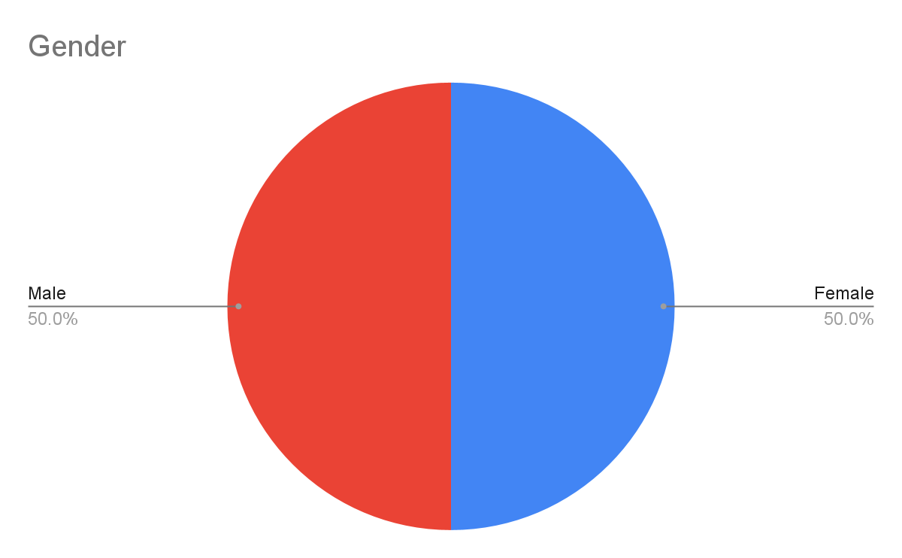
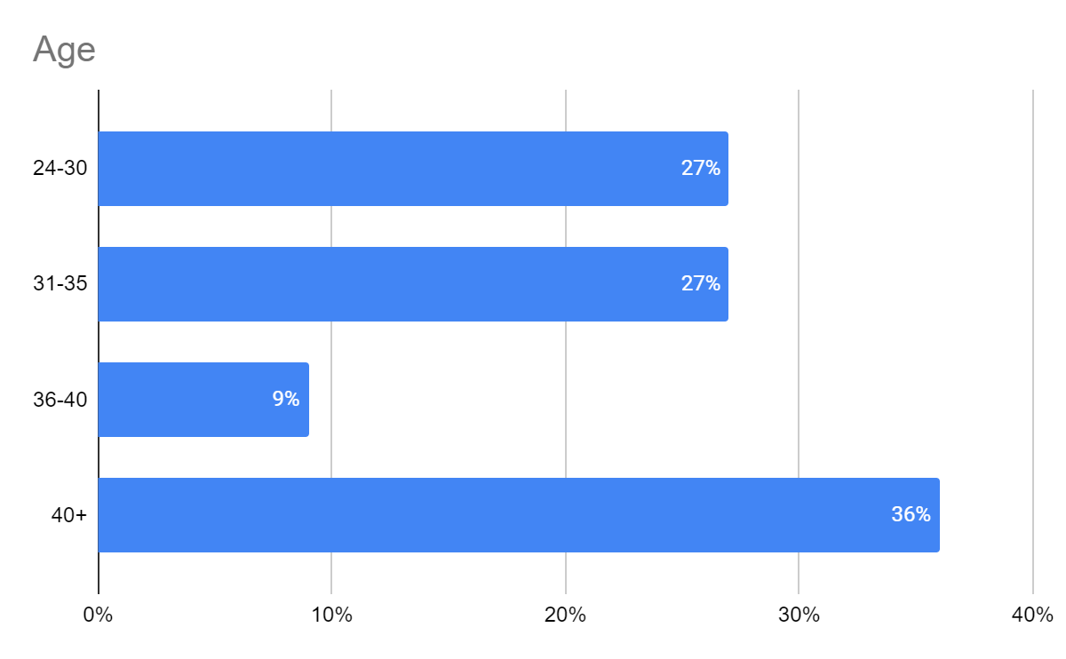
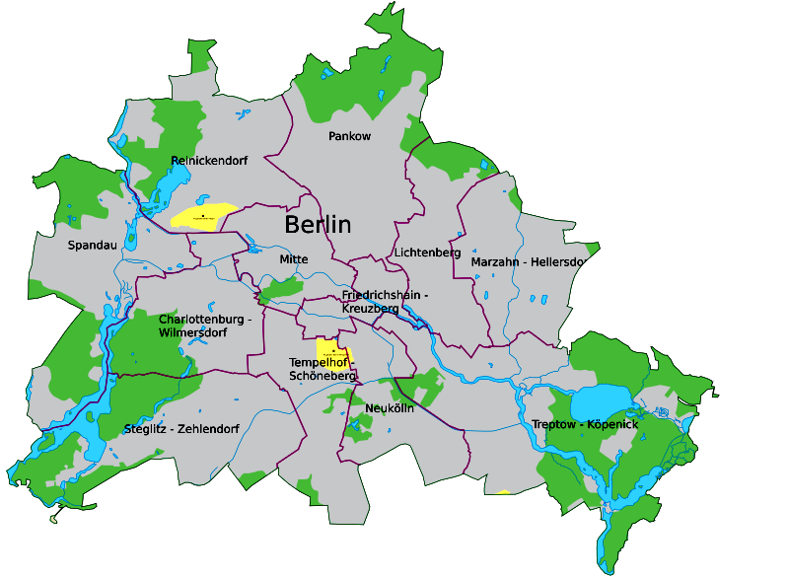

Demographics
Gender
Age
District
25%
Descriptives:
Mean: 36.4
Median: 35
Mode: 30
25%
25%
8.3%
16.7%
n=12

Slide 4
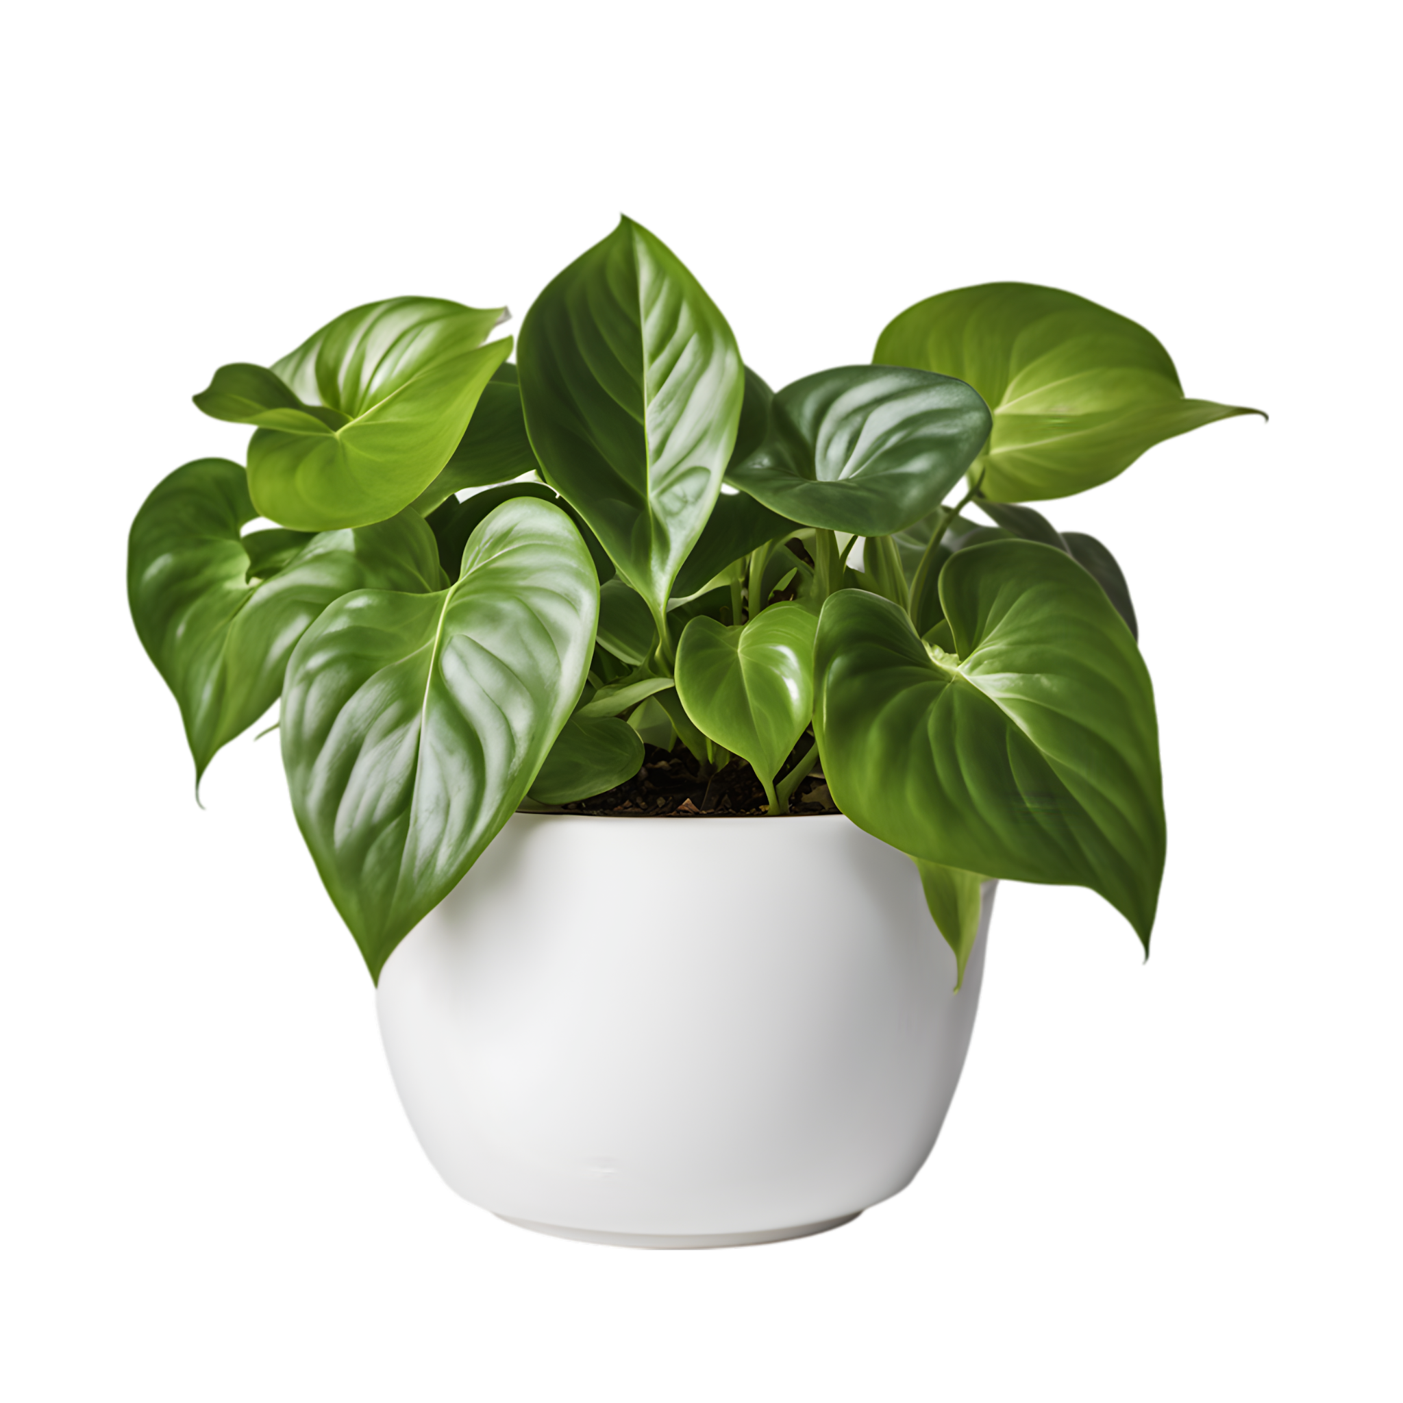
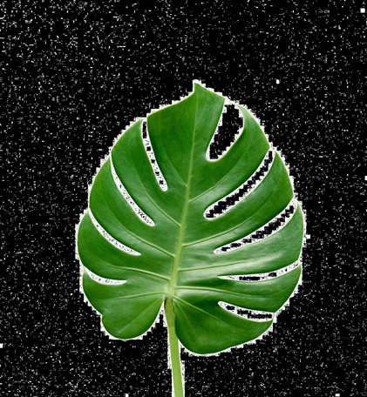
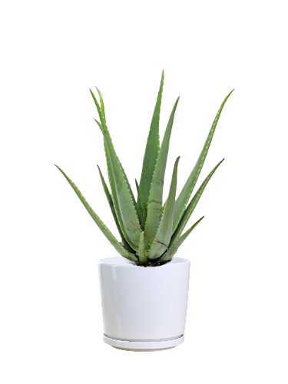
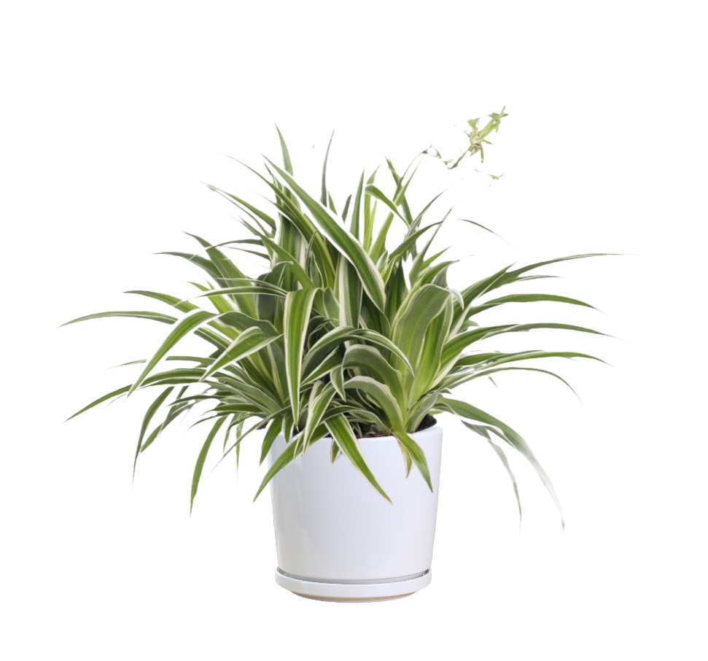
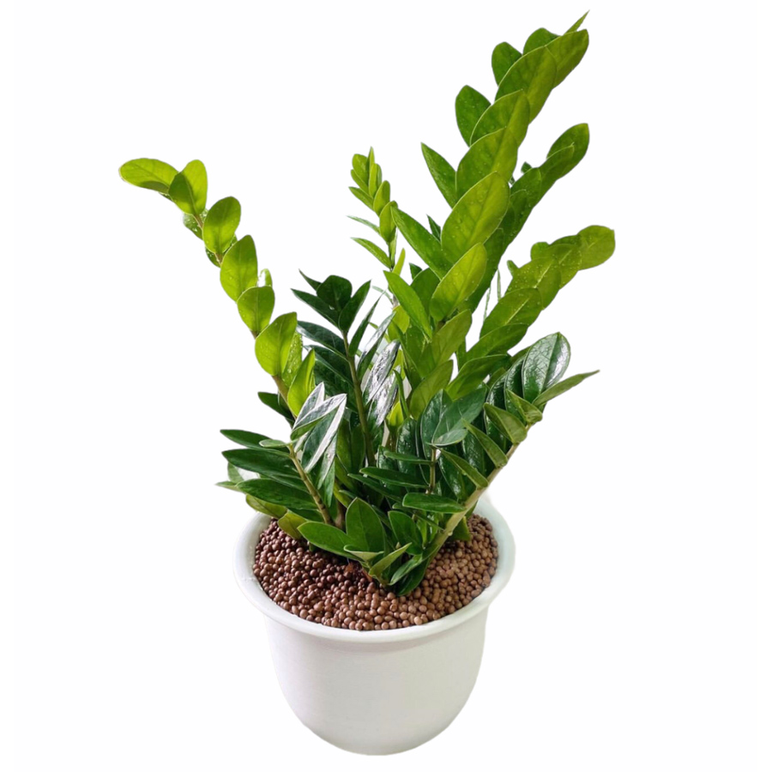
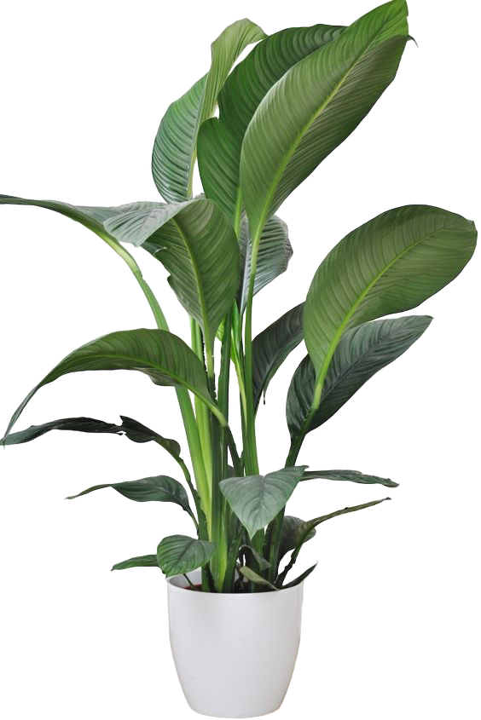
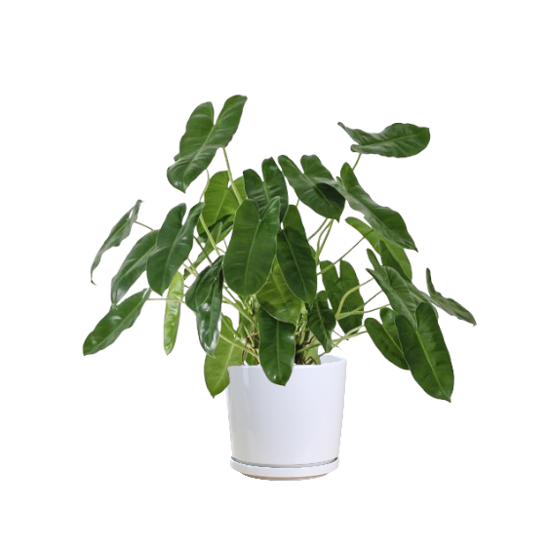
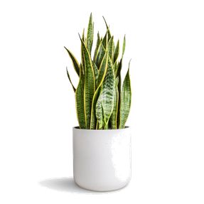

Main Questions
100%
Pothos=7
Monstera=6
Aloe Vera=5
Plant Ownership among
Minty Floats
Total Number of plants:119
Average:10 (9.9)
Min:2
Max:30
Median:9
Mod:2, 5, 12
Spider Plant=5
ZZ Plant=4
Peace Lily=3
Philodendron=3
Snake Plant=3
Other (Total)= 12
n=12
Notes:
Among others we have Aloca sia, Bird of paradise, bowhemp, cactus, Cactus
Ceropegia Haworthia Hibiskusivy plant Orchideen Rose bush rubber tree

Slide 5
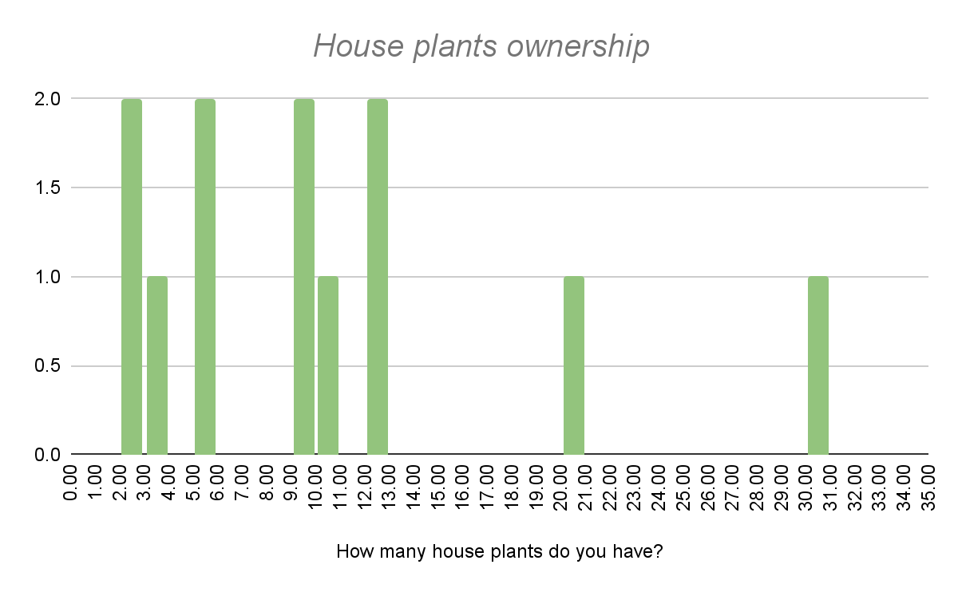
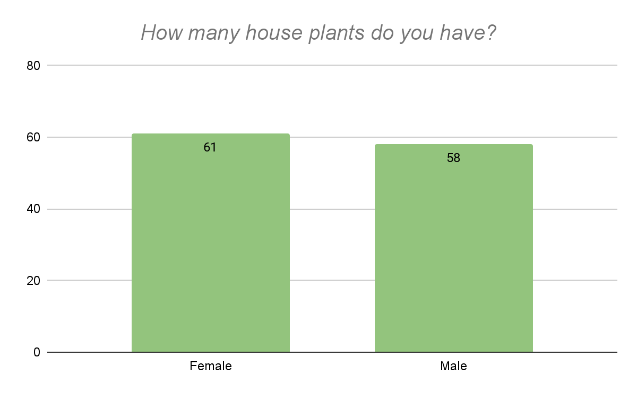
DETAiled Comparison Male vs FEmale
Number of people
Number of total plants
The whole class
Mean: 9.9
Median: 9
Female
Mean: 10.2
Median: 7.5
Male
Mean: 9.7
Median: 9
n=12

Slide 6
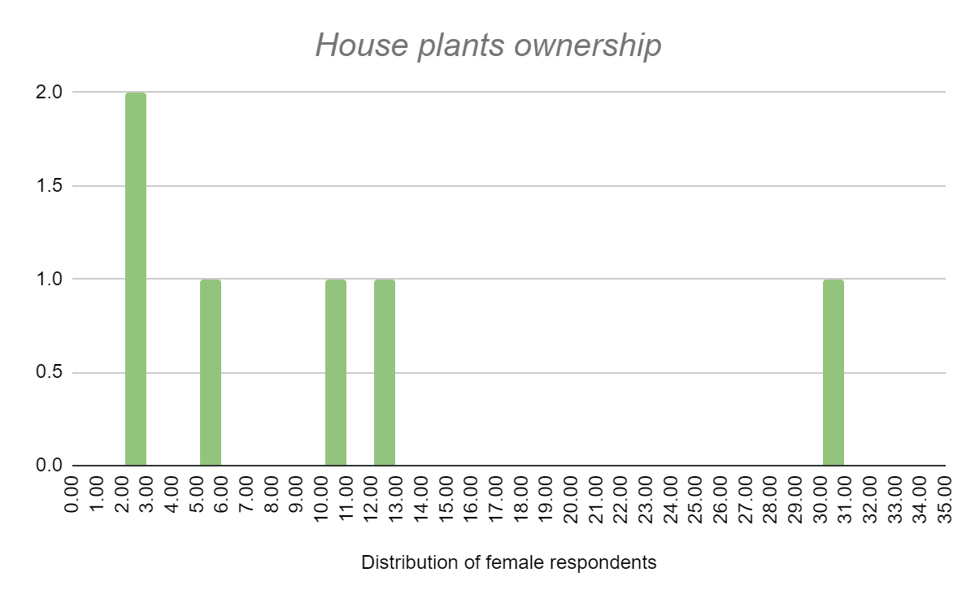
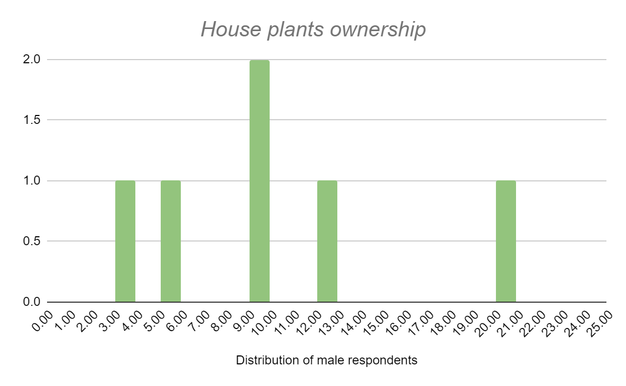
DETAiled Comparison Male vs FEmale
Number of people
The whole class
Mean: 9.9
Median: 9
Female
Mean: 10.2
Median: 7.5
Male
Mean: 9.7
Median: 9
n=12

Slide 7
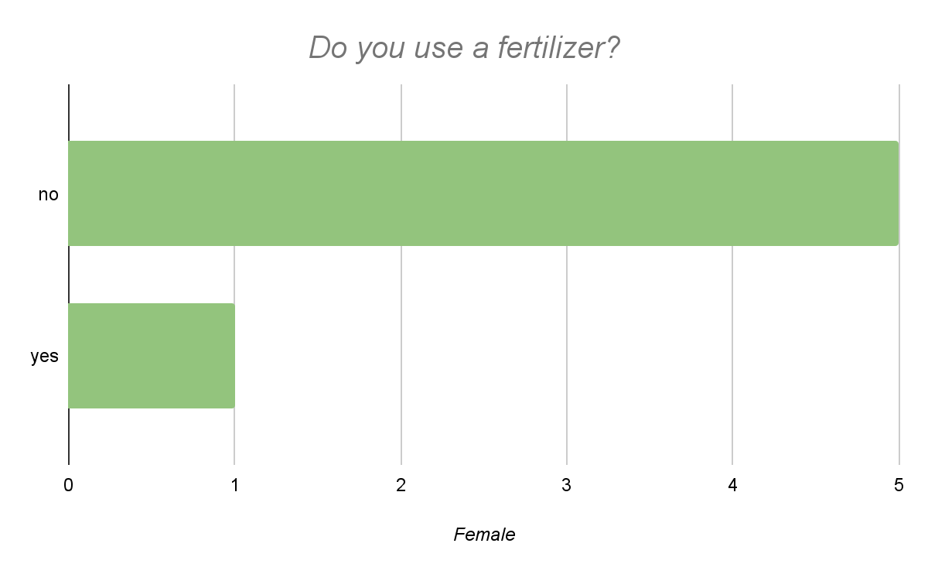
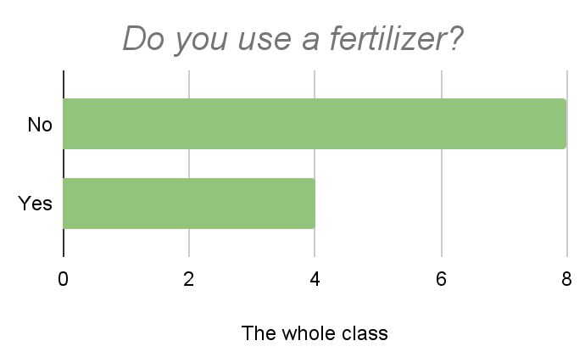
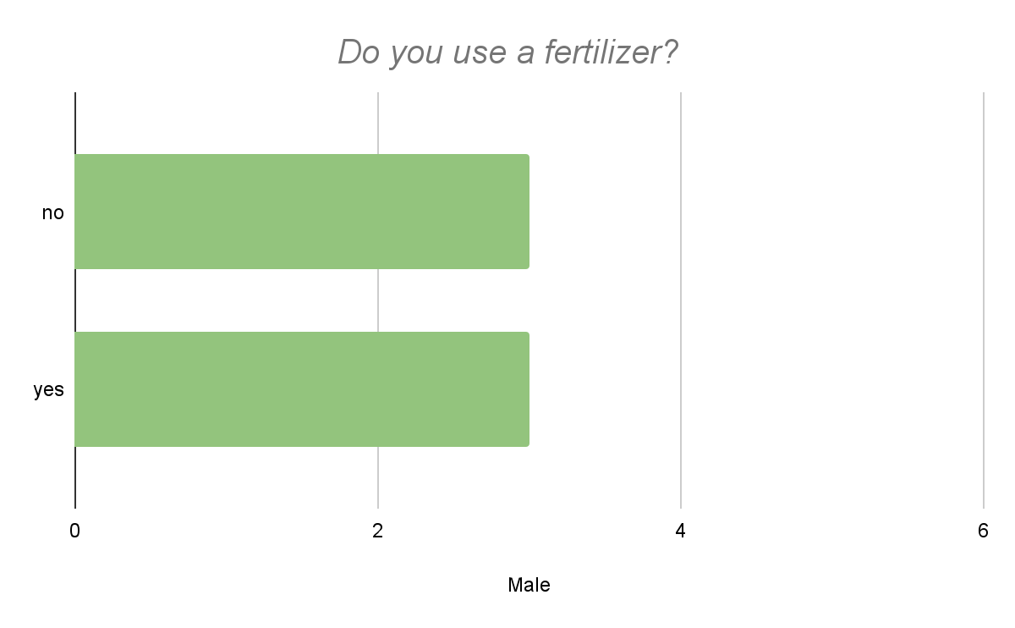
Plant cAre Behaviour
n=12

Slide 8
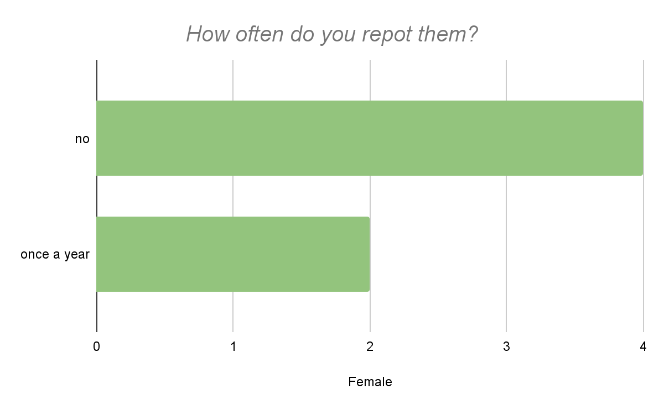
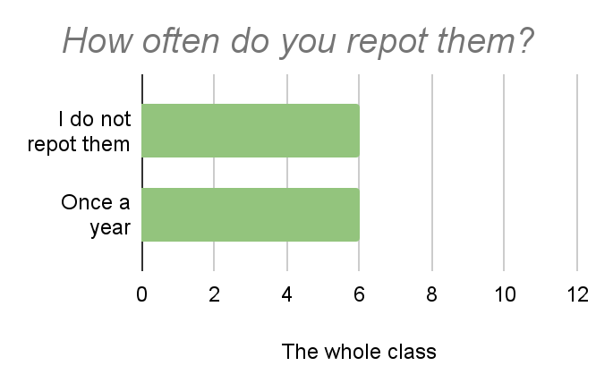
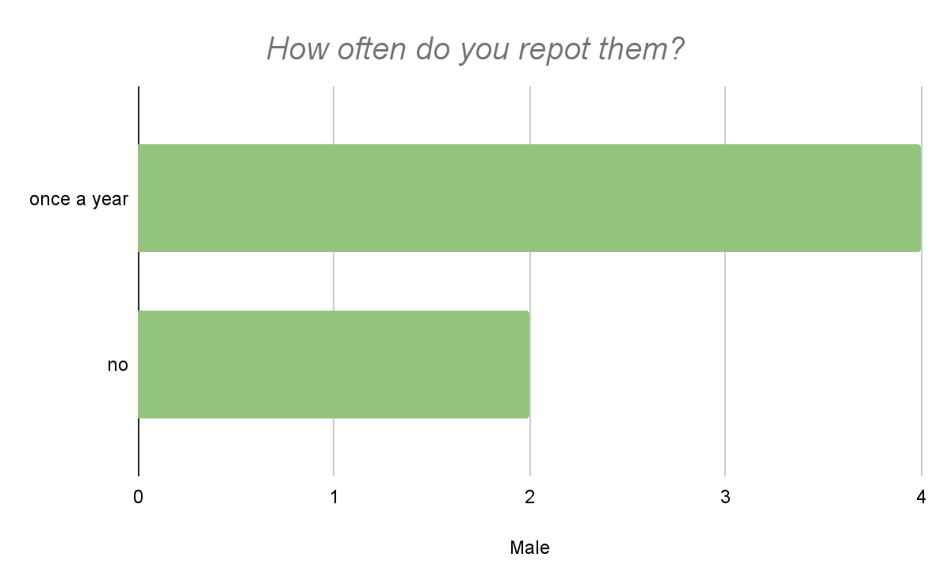
Plant cAre Behaviour
n=12

Slide 9
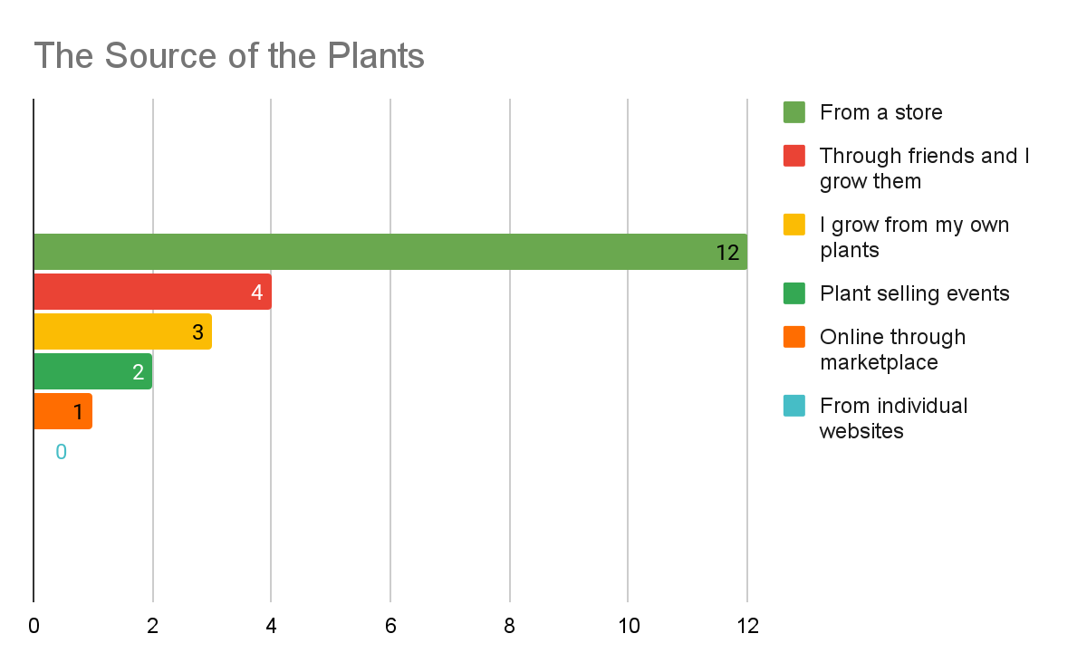
Buying Behaviour
n=12

Slide 10
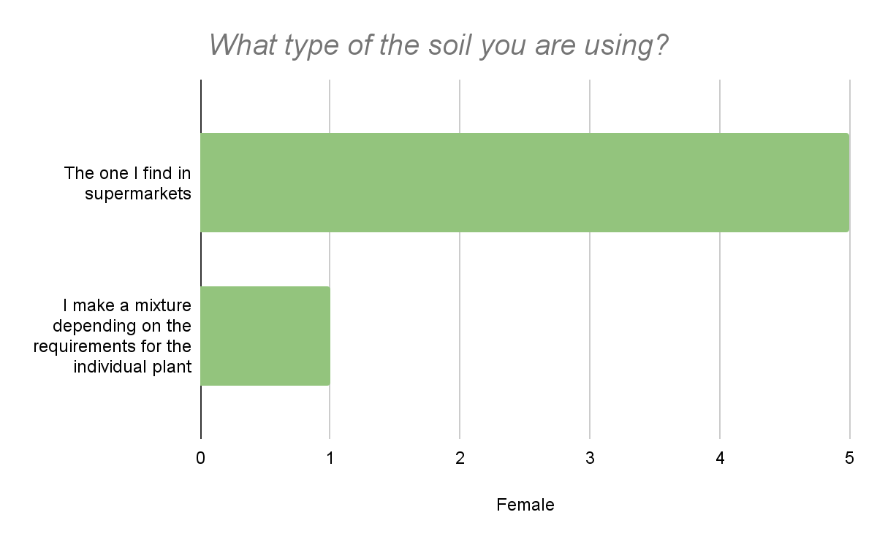
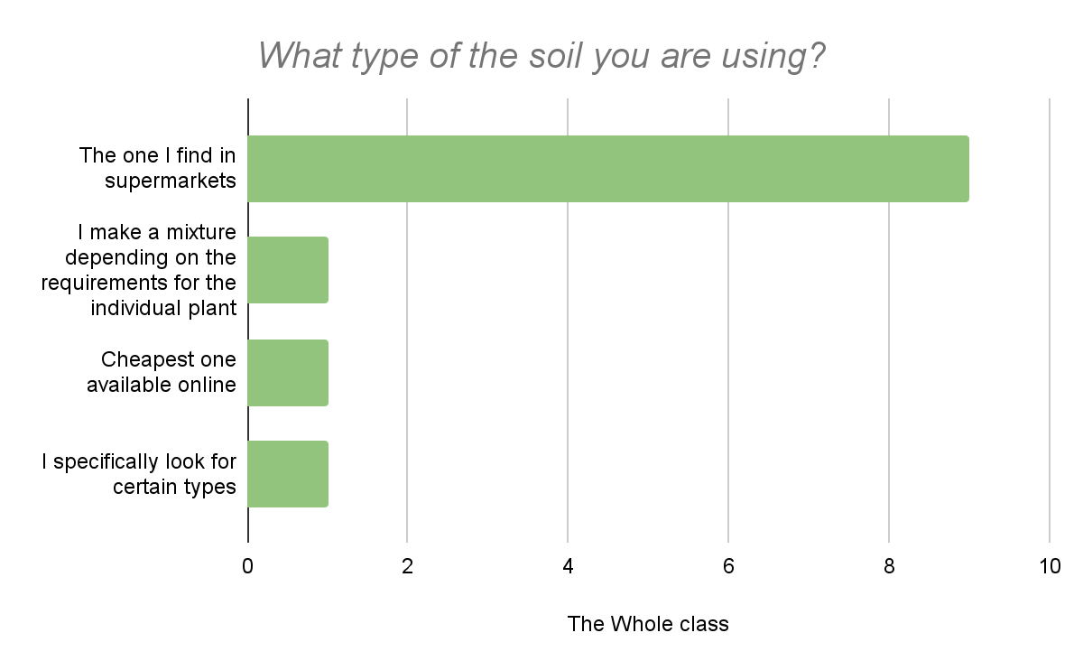
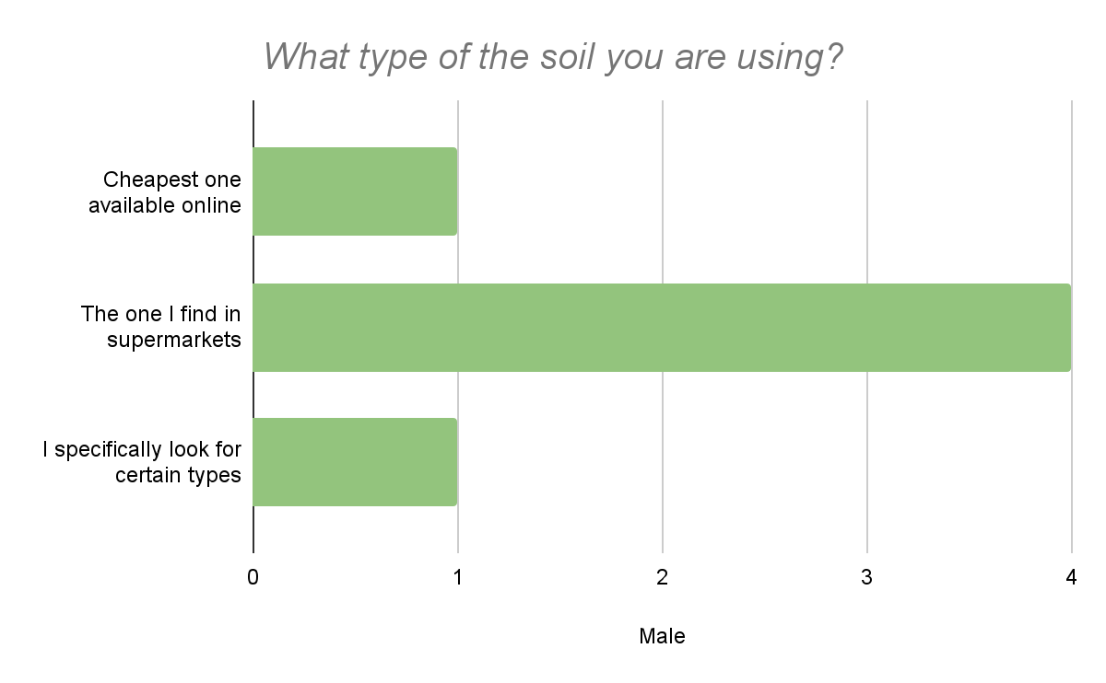
Plant cAre Behaviour
n=12

Slide 11
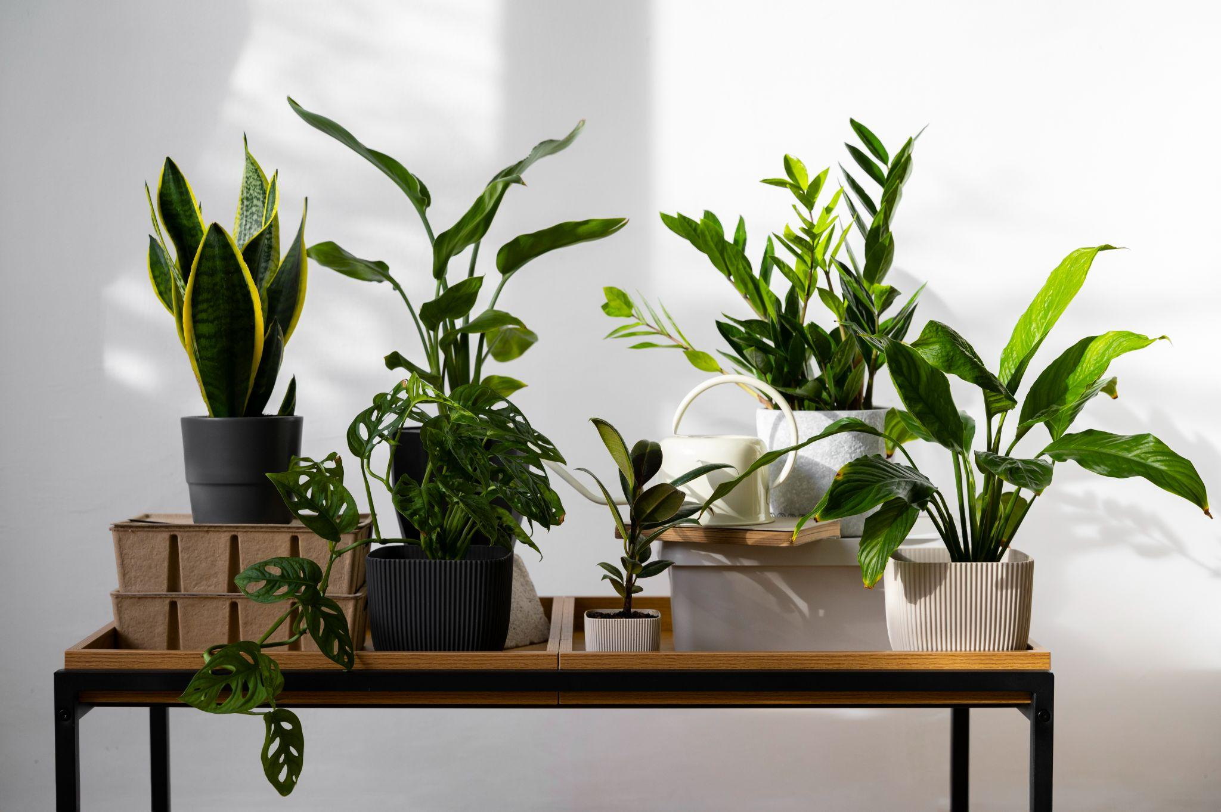
Q & A

Slide 12
Thank You
Link to the Survey

